Slide 1

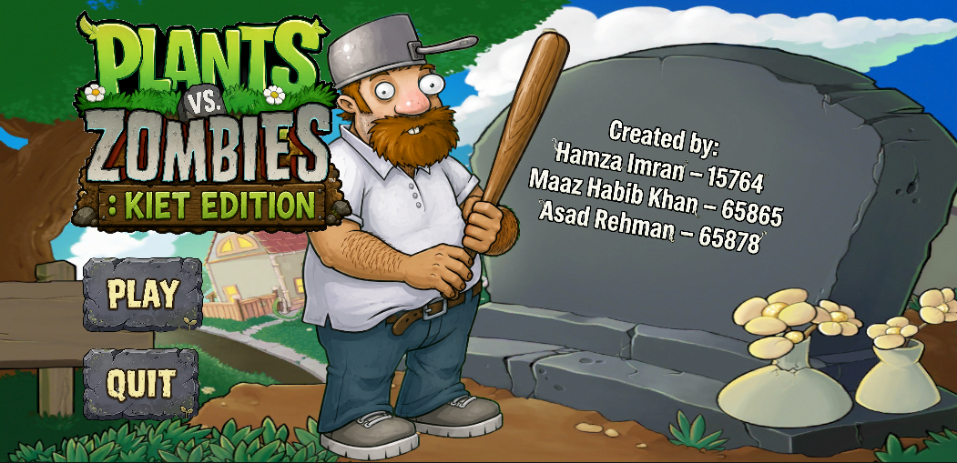
Team Fortress Defense
A 2D side-scroller survival mobile game
Group Members:
Hamza Imran — 15764
Maaz Habib Khan — 65865
Asad Rehman — 65878
Submitted TO : Miss Erum Aman

Slide 2
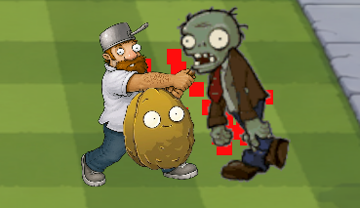
Project Overview
Our project is a 2D side-scroller built on open source game engine unity. The game lets user face hordes of zombies by their trusty bat and plants allies. The user have to use offensive tactics while maintaining their defense.
Platform: Mobile (Unity)
Genre: Action + Survival (Hybrid)
Primary audience: Mobile players

Slide 3
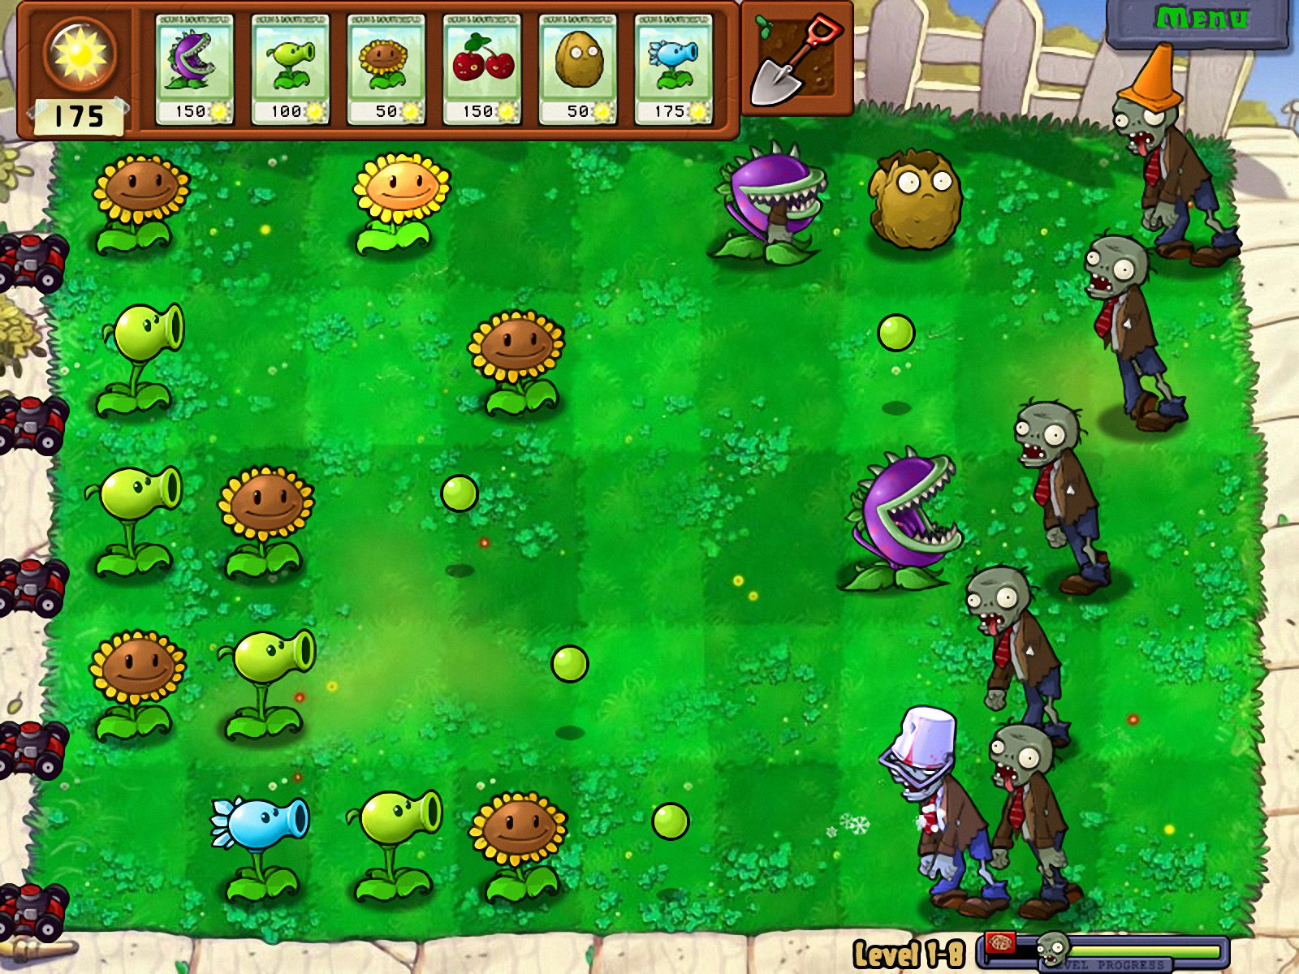
Why this ?
At one point most of us have played Plants vs Zombie once and the thing that always bothered me was that it was static. You get new plants but we just have to place them the same place and let them do the work.
So we had an idea to add a new character which give us freedom to move while demolishing those zombies.

Slide 4
Objectives
Responsive Controls
Wave Spawning
Hero Mechanic
Polished on-screen controls for movement and attacks optimized for touch input.
Scalable, wave-based enemy system with progressive difficulty tuning.
High-impact playable character with upgraded stats and abilities.
Pleasing UI & UX
Mobile Performance
User friendly and theme based UI, UX making user feel more immersed.
Unity optimizations to maintain stable frame-rates across typical devices.

Slide 5
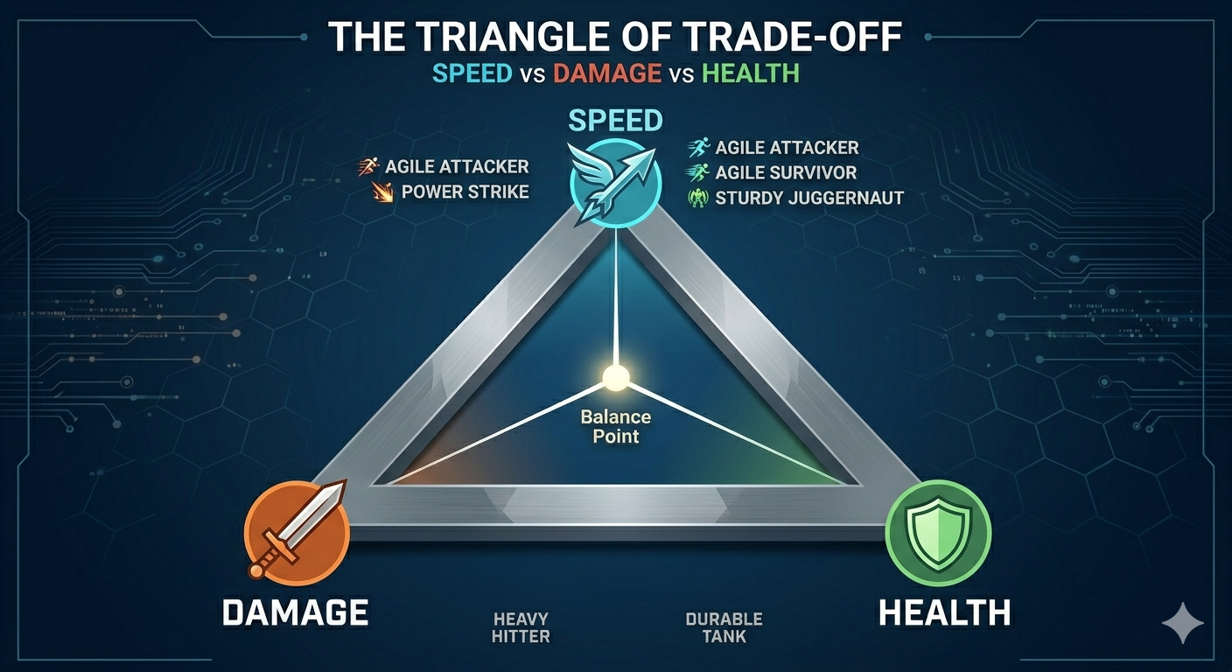
System Users & Roles
Player (Primary)
Controls Hero movement/attacks, manages currency to summon backups, and monitors tower health to survive waves.
Admin / Dev Team
Tune balance (enemy stats, unit costs), monitor telemetry (performance, high scores), iterate on difficulty curves.

Slide 6

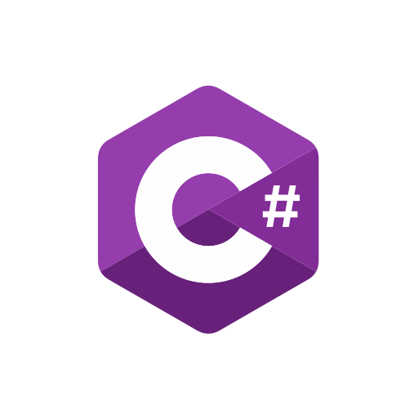


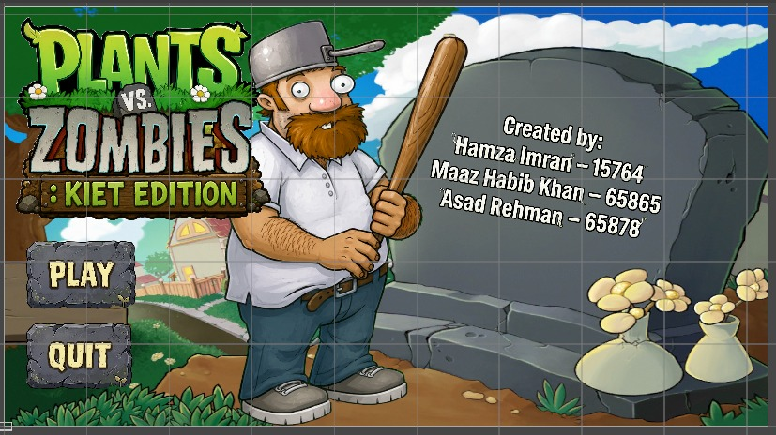

Technical Plan & Methodology
Development is split into iterative milestones: requirements, prototyping, asset integration, gameplay programming, testing, and polish. We follow an agile cycle with playtest-driven balancing.
Tools & Tech
Requirement analysis → define stats & wave tables
Asset pipeline → import 2D sprites & environment tiles
C# scripting in Unity → movement, AI, spawn manager, UI
Testing → performance, balance, touch ergonomics
Unity
Primary engine for mobile deployment and performance optimizations.
C#
Game logic, AI, and systems scripting.
Git
Version control and collaborative workflow.
VS / VS Code
Code editing and debugging tools.

Slide 7
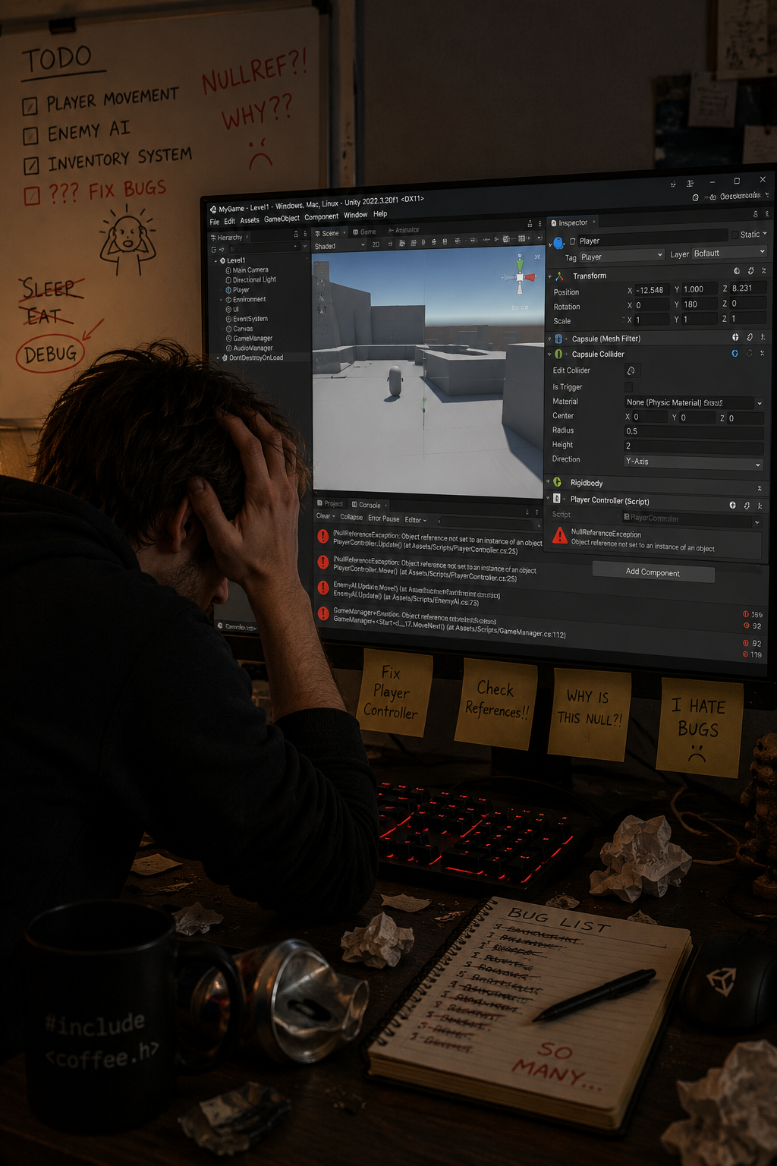
Problems we faced
Most of us weren’t familiar with Unity and most of all none of us have ever worked on a game project so with that came problems that we never have faced:
Experience different components of unity
Allies / Enemy AI working
Balancing: Giving personalities to different plants and enemy
Interaction between Code and editor

Slide 8
What We Achieved
Included
Excluded (Out of Scope)
Side-scrolling movement & combat mechanics
Health system
Wave-based enemy AI spawn
Allies with their personal identity and AI
Online multiplayer (reserved for future updates)
In-game currency / shop system
Advanced procedural world generation

Slide 9
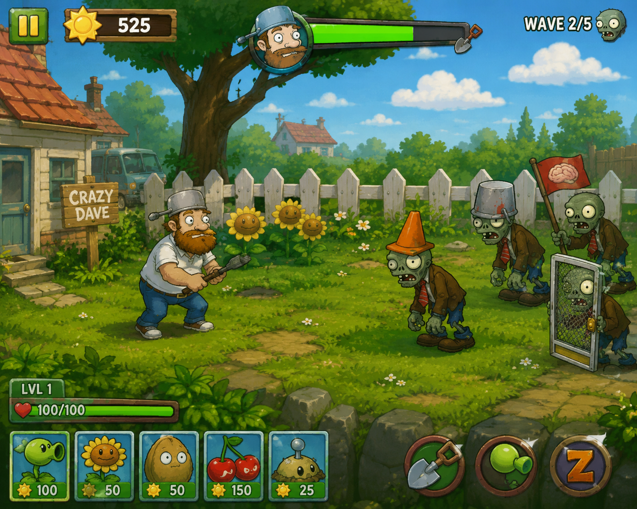
Future Improvements
Graphical Improvement
More levels getting difficult progressively.
More variety in plants and zombie.
In-game currency management.

Slide 10
Thank you

